Slide 1
Instructions to Trainer/Facilitator on how to get the evaluation filled
Keep 15 minutes exclusive time for seeking evaluation on last day of training.
Ensure projector has maximum brightness for QR code to be clearly visible.
Check the room have sufficient light to enable participants to scan QR code properly.
Inform participants about intent to get the evaluations filled and its confidentiality
Ensure participants confirmation that they have submitted evaluation before the training wraps up.
In case any user is not able to access QR code, share evaluation link with them on their official email id

Slide 2
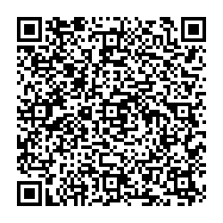
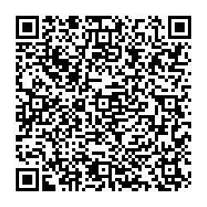
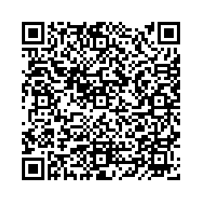
Participants Instructions on how to provide training evaluations
Kindly have your mobile connected to internet.
Scan the QR Code shown on screen from your mobile camera and slightly tilt the phone to read the code, if QR code is not being read.
In case your mobile camera is not able to access the QR code at all, advise is to download any QR code scanner app from Google play store or Apple Store and then scan the code from the app.
Follow the steps on your screen to login, details below will be asked:
Login using your Ericsson email id & password
Provide passcode, generate it from VIP Access app on your mobile
The survey will appear and will have 8 questions.
Submission of evaluation will also be a feed for your attendance in ITM. Hence, it is important that you provide feedback.
Note to Instructor: Right click on the box and click on copy link to share with participants if needed.
Link

Slide 3
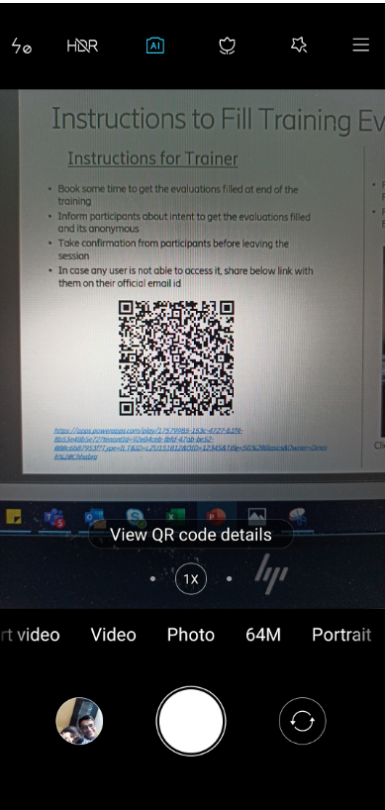
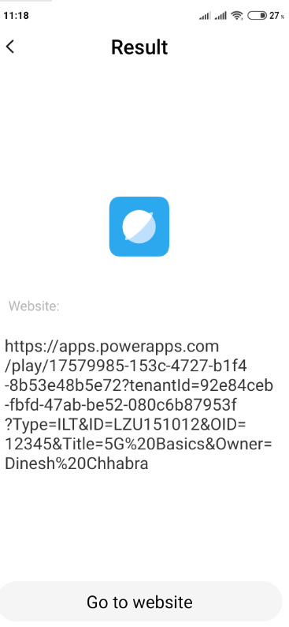
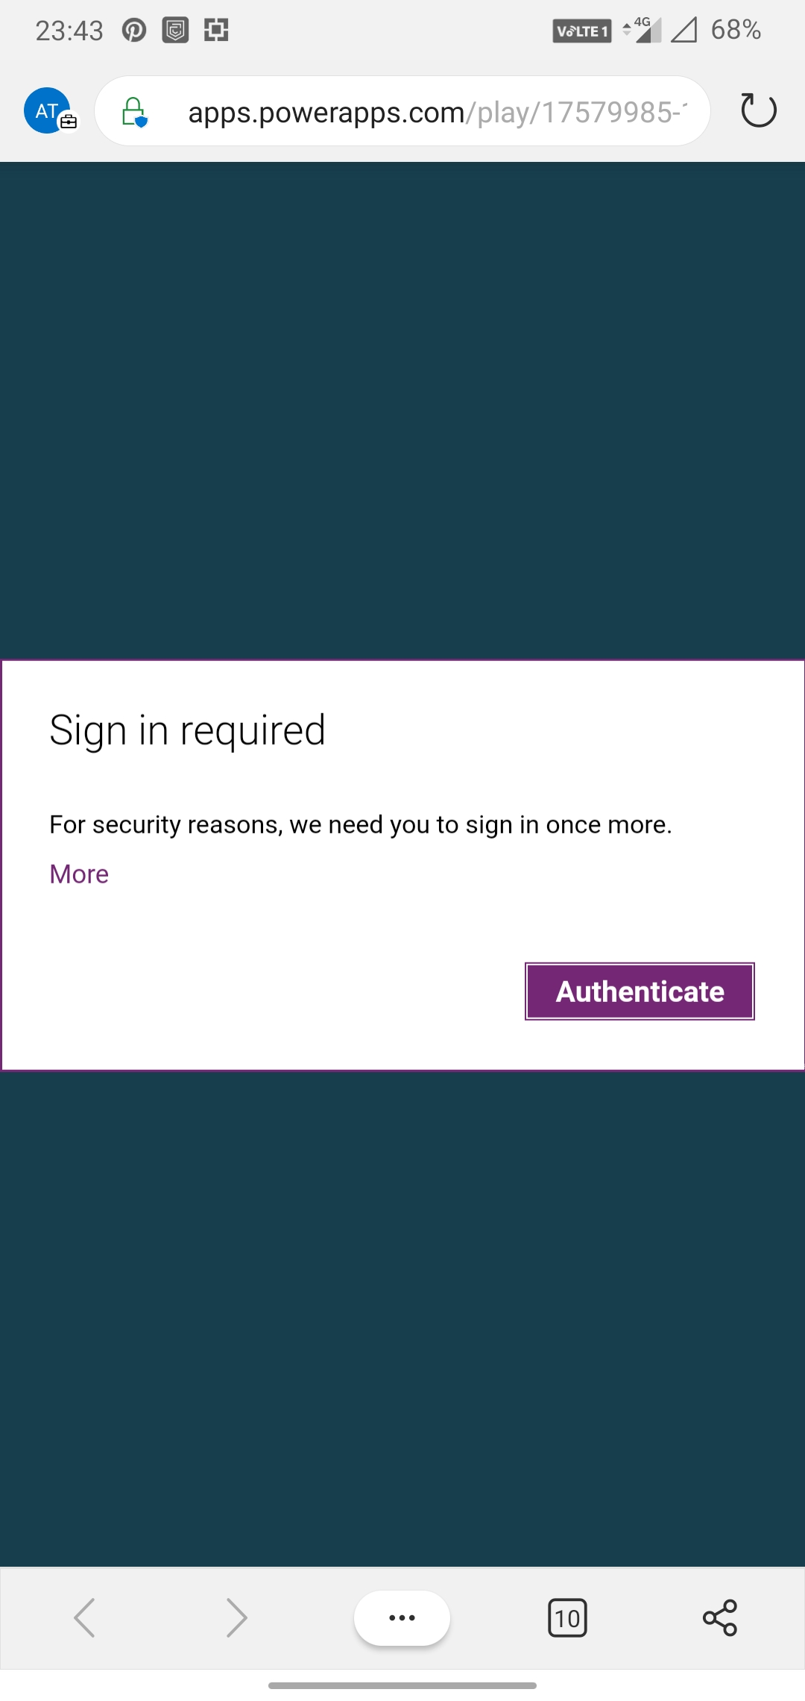
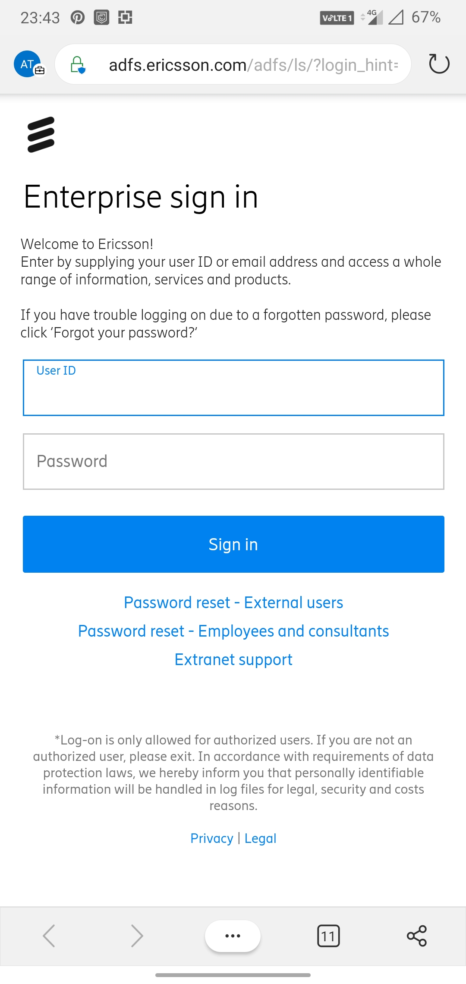
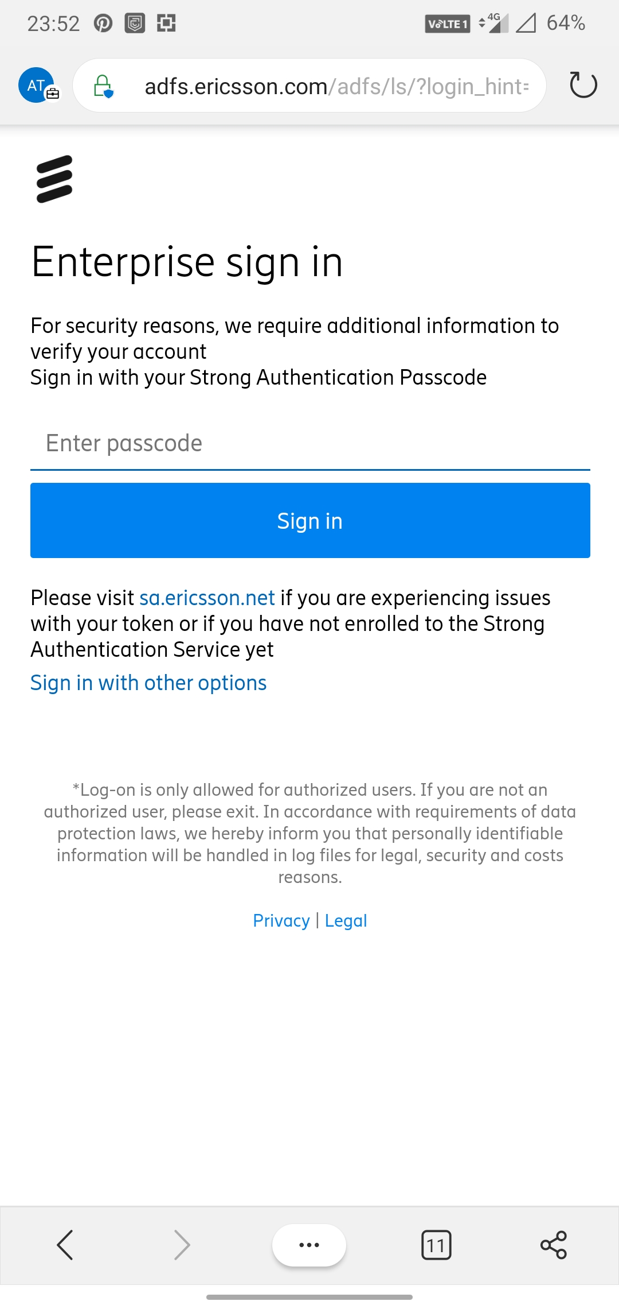
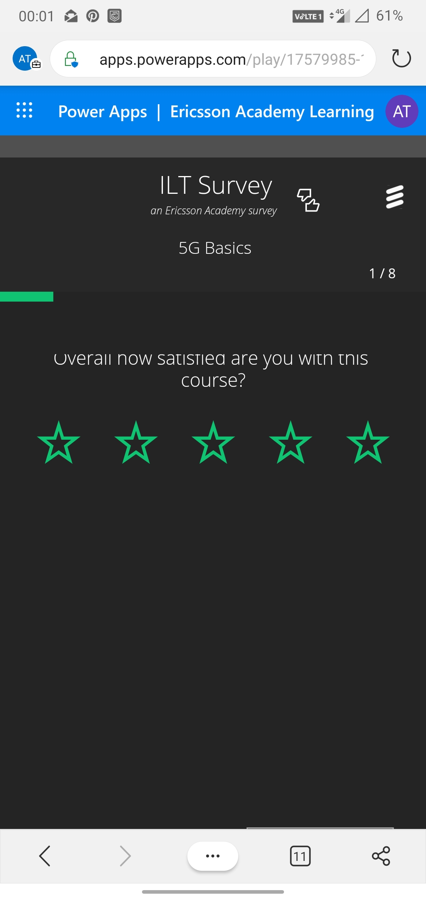
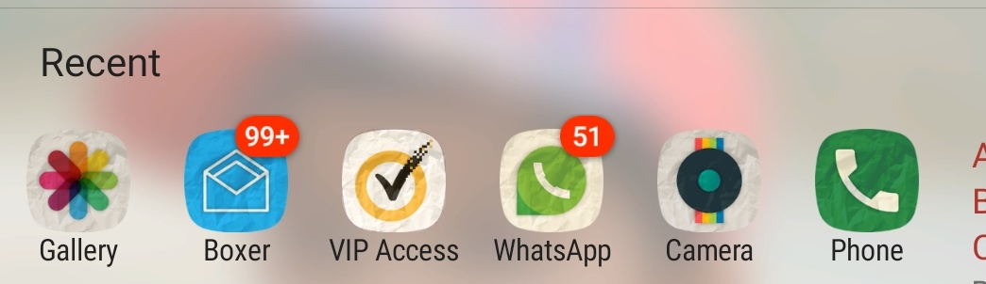
Screenshot on how to access survey
VIP access app for passcode
User Guide on SharePoint for how to install VIP Access

